Slide 1
Linguistic complexity:
from the eye of the beholder to corpus based measures in East Caucasian
Michael Daniel & Anastasia Panova

Slide 2
Preamble

Slide 3
What is all the fuss about?
Measuring complexity in typology is deemed relevant for the evolutionary and / or sociolinguistic take on language diversity, connecting complexity of language structures to such diverse but correlated factors as language evolution, language spread, spatial distribution of language types, language size, linguistic isolation, L2 acquisition and multilingualism of its speakers etc.

Slide 4
Haudricourt 1961: Richesse en phonème et richesse en locuteurs
De la conclusion:
L'enrichissement ou rappauvrissement en phonèmes d'une langue semble donc en relation avec l’importance du nombre de bilingues, qui est lui-même fonction des relations de réciprocité avec les sociétés voisines et des dimensions absolues du groupe: pour un petit groupe, toute la population est frontalière, donc bilingue; plus le groupe est important, plus la proportion des frontaliers diminue.

Slide 5
Nichols 1992: Linguistic Diversity in Space and Time

Slide 6
Trudgill 2004: The Austronesian migrations and phoneme inventories
From conclusions:
(i) In cases where there is long-term language contact involving child-language acquisition, high degrees of language contact may lead to larger phoneme inventories, as a result of borrowing, as suggested by Nichols.
(ii) Situations involving adult language contact, on the other hand, are likely to favour medium-sized phoneme inventories, i.e., inventories which are not so large as to be difficult for adolescents and adults to remember and acquire, but not so small as to cause confusability of constituents and high word length.
(iii) Low degrees of language contact may lead to languages with small inventories, because the memory load difficulties caused by confusability and word length will not be relevant, since post-critical threshold learning is not involved. They may also just as well lead, however, to large inventories, because, equally, the memory load difficulties caused by the acquisition of large numbers of phonemes will not be relevant either. We have as yet no explanation for why one of these factors may come to dominate the other.
(iv) Large community size will favour medium-sized phoneme inventories, i.e., inventories which are not so small as to cause communicative difficulties as a result of a low degree of redundancy.

Slide 7
Trudgill 2004: The Austronesian migrations and phoneme inventories
From conclusions:
(v) Languages spoken in small communities can develop very small inventories since lower degrees of redundancy can be tolerated because of the large amounts of shared information present. Small communities can also, equally, develop very large inventories because of the ability of such communities to encourage continued adherence to norms from one generation to another, however complex they may be. We have as yet no explanation for why one of these factors may come to dominate the other. One possibility is that we should distinguish between isolated communities which do, however, have neighbours, such as the San and the Yele, and isolated communities which do not, such as the Hawai’ians. As has been suggested by Thurston (1994), small communities which have neighbours, but which wish to remain as isolated as possible, may elaborate systems in order to make them more opaque to these neighbours. However, it is not at all clear that this can occur in the case of phoneme inventories – can speakers deliberately expand phoneme inventories at will?

Slide 8
Phoneme inventory size and population size
Hay and Bauer 2007: This short report investigates the relationship between population size and phoneme inventory size, and finds a surprisingly robust correlation between the two. The more speakers a language has, the bigger its phoneme inventory is likely to be. We show that this holds for both vowel inventories and consonant inventories. It is not an artifact of language family.
Followed by: Moran, McCloy & Wright 2012: In this discussion note we argue against the findings presented in Hay & Bauer 2007, which show a positive correlation between population size and phoneme inventory size. We argue that the positive correlation is an artifact of the authors' statistical technique and biased data set. Using a hierarchical mixed model to account for genealogical relatedness of languages, and a much larger and more diverse sample of the world's languages, we find little support for population size as an explanatory predictor of phoneme inventory size once the genealogical relatedness of languages is accounted for.*

Slide 9
Atkinson 2011 (and the following discussion in Science)
Phonemic Diversity Supports a Serial Founder Effect Model of Language Expansion from Africa
Abstract: Human genetic and phenotypic diversity declines with distance from Africa, as predicted by a serial founder effect in which successive population bottlenecks during range expansion progressively reduce diversity, underpinning support for an African origin of modern humans. Recent work suggests that a similar founder effect may operate on human culture and language. Here I show that the number of phonemes used in a global sample of 504 languages is also clinal and fits a serial founder-effect model of expansion from an inferred origin in Africa. This result, which is not explained by more recent demographic history, local language diversity, or statistical non-independence within language families, points to parallel mechanisms shaping genetic and linguistic diversity and supports an African origin of modern human languages.
(Followed by a hot methodological discussion)

Slide 10
Baechler 2017: Complexity, isolation and language change
Abstract: This paper investigates synchronic and diachronic complexity in the nominal inflection of 17 isolated and non-isolated Alemannic varieties. Synchronic complexity is the degree of complexity a variety is comprised of at a specific time, thus, the result of the loss, maintenance and growth of complexity in a variety. Diachronic complexity refers to complexification and simplification (i.e. change in complexity), meaning innovations which lead to higher or lower complexity. The paper tests whether an interrelation between synchronic complexity and isolated/non-isolated language communities can be observed, and whether there is an interrelation between complexification and simplification respectively and isolated/non-isolated language communities. The method to measure synchronic complexity is based on Paradigm Function Morphology (Stump 2001 and Ackerman/ Stump 2004). The degree of complexification/simplification is determined by the number of innovations leading to higher/lower complexity. Firstly, it is shown that no clear correlation between synchronic complexity and isolation can be observed. Secondly, non-isolated dialects are affected to a greater extent by simplification as well as complexification (i.e. by language change) than isolated dialects.

Slide 11
Meausures

Slide 12
Problematizing complexity
Nichols 1992: 64 on her measurements of complexity in head - dependent marking:
“How to measure morphological complexity is itself an issue of some complexity.”
Then she proceeds: “The measure I use is simply the total of D(ependent), H(ead), and F(loated) points for NP and S (I omit PP since the languages lacking it or lacking descriptions of it would have their complexity artificially lowered if I counted it). This measure overlooks a good deal of the actual morphological complexity of languages, both in omitting categories commonly signaled by morphology (e.g., tense and aspect on verbs) and in considering only where and whether something is marked but not how (e.g., by inflection, agglutination, cliticization, or incorporation). Its advantage lies in its simplicity: it requires no additional survey or analytic work once the head/dependent type features are assessed. It is my impression that complexity as measured here, partial and artificial though it is, correlates straightforwardly with overall morphological complexity and can hence be used as an index of something real.”
*

Slide 13
Problematizing complexity
Phonetic complexity: features or inventories? allophones, “soundtypes” or phonemes? native or
Yet on the empirical side, measuring complexity is difficult not only because the measures are sometimes calibrated in what may seem an arbitrary way, but also - and certainly not less importantly - because they depend on the analysis in a grammar. As one example, Kibrik (1977) counts over a million of synthetic verbal forms in Archi; but excluding verificative and especially quotative 'series' from inflectional morphology dramatically reduces this abundance. Similarly, measuring phonetic complexity based on the cardinality of inventories may deliver different stories depending on the approach; the status of [x] in Archi (only Russian loans) is very different from its status in Rutul (native lexicon); including or excluding rare allophones (Archi [ɮ]) and variants (Mehweb [ɣ]) that sometimes do and sometimes do not make their way into the descriptive inventories could in theory influence the outcomes of the quantitative comparison, and it is not absolutely obvious what can be the impact of these factors on the comparison.

Slide 14
Problematizing complexity
Morphological complexity: highly dependent on analysis
As one example, Kibrik (1977) counts over a million of synthetic verbal forms in Archi
The quotative, interpreted as a special series (комментатив) is based on integration of a verbal stems that partially preserves predicative independence (Chumakina 2019) in the sense that it attaches to inflected forms and takes inflections itself, and overall is intermediate between a morphological bound element and a clitic. Removing the quotative series dramatically reduces the abundance.
Because of patterns of homophony, the four distinct forms of a verb inflected for gender may be interpreted as up to 10 (and more) different values of gender - though practically only six or seven are posited.

Slide 15
Classical approaches to measuring complexity
McWhorter 2001
a language is more complex than another if it has
more cross-linguistically rare sounds in the phonemic inventory (e.g., clicks)
more syntactic rules (e.g., different word order in main and dependent clauses)
more fine-grained semantic and/or pragmatic distinctions (e.g., different existential verbs for objects of different shape)
inflectional morphology
“the world’s simplest grammars are creole grammars”

Slide 16
Classical approaches to measuring complexity
Nichols 2009
the surveyed features:
Phonology: number of contrastive manners of articulation; tones; syllable structure, etc.
Synthesis: inflectional synthesis of the verb; polyagreement; noun plural/dual marking.
Classification: numeral classifiers; overt possessive classes; gender.
Syntax: number of different alignments and basic word orders.
Lexicon: inclusive/exclusive pronouns; distinct roots in plain and causative verbs; overt derivations in verb pairs.
68 languages with all categories filled
from Basque (13.0 points, minimum) to Ingush (27.9 points, maximum)

Slide 17
Classical approaches to measuring complexity
Nichols 2020 (only morphological complexity)
Two types of complexity
enumerative complexity (EC): the number of elements in an inventory
canonical complexity (CC): the number of non-canonical patterns or elements
105 languages found in both EC and CC samples
17 variables across seven inflectional categories and three parts of speech

Slide 18
Corpus-based measures of complexity
Information-theoretic measures
Kolmogorov complexity (Juola 1998, 2008; Ehret & Szmrecsanyi 2016; Ehret 2018 among others)
complexity of a string is the length of the shortest possible description of that string
can be approximated by using file compression programs (e.g., gzip)
cdcdcdcdcd (10 characters) → 5×cd (4 characters) | less complex string
cdgh39aby7 (10 characters) → cdgh39aby7 (10 characters) | more complex string
morphological complexity score | = | the compressed file size after deleting 10 % of the orthographic characters
 |  | the compressed file size before deleting 10 % of the orthographic characters
syntactic complexity score | = | the compressed file size after deleting 10 % of the word tokens
 |  | the compressed file size before deleting 10 % of the word tokens
Notes:
Examples from Ehret & Szmrecsanyi 2016

Slide 19
Corpus-based measures of complexity
Information-theoretic measures
Shannon entropy (Bentz et al. 2016; Sozinova et al. 2019 among others)
a measure of (un)predictability of the particular symbol/word in a string
depends on the corpus size!
many symbols/words with high probability | less bits are needed for encoding it | lower entropy
many unique symbols/words and symbols/words of lower probability | more bits are needed for encoding | higher entropy

Slide 20
Corpus-based measures of complexity
Type-token ratio (TTR), usually used as a measure of lexical diversity (e.g., in studies of child language) but also reflects morphological complexity (Kettunen 2014; Gutierrez-Vasques & Mijangos 2020 among others)
TTR depends on the corpus size (Heap’s law)
TTR | = | the number of types
 |  | the number of tokens
MATTR (Moving-Average Type-Token Ratio)
“We choose a window length (say 500 words) and then compute the TTR for words 1–500, then for words 2–501, then 3–502, and so on to the end of the text. The mean of all these TTRs is a measure of the lexical diversity of the entire text and is not affected by text length or by any statistical assumptions” (Covington & McFall 2010, cited by Kettunen 2014: 229)

Slide 21
Corpus-based measures of complexity
Measures which require annotated corpora
Mean size of paradigm (MSP) (Xanthos & Gillis 2010)
Morphological feature entropy (MFE) (Coltekin & Rama 2018)
Kolmogorov complexity & software package Linguistica (Bane 2008):
where DL(x) is the description length of x
and many others
Notes:
“signatures” describe the possible distributions of affixes upon stems

Slide 22
Corpus-based measures of complexity
What measure to choose?
Type-token ratio (TTR)
✔ “the simplest corpus-based measure” (Bentz et al. 2016: 149)
✔ does not require any special annotation
✔ C_{WALS}* is highly correlated with TTR (Gutierrez-Vasques & Mijangos 2020: 11)
❌ “does not distinguish between effects due to breadth of the base lexicon, on one hand, and word formation processes such as derivation, inflection or compounding, on the other” (Bentz et al. 2016: 149)
* C_{WALS} is a complexity score based on 28 WALS features of morphology (Bentz et al. 2016)

Slide 23
Phonetic complexity in Daghestan

Slide 24
Descriptive data:
Informally: complex phonologies
Kibrik on Archi: extremely rich consonant inventory (80+)
Haudricourt 1961 on Dumezil and Vogt on Ubykh: “une langue caucasienne, l’oubykh, qui est probablement la langue du monde ayant le maximum de consonnes”

Slide 25
Descriptive data:
Ubiquity of:
uvulars
postradicals
ejectives
intensives
common use of labialization
Presence of:
nasalization
limited use of length
common use of pharyngealization

Slide 26
Descriptive data:
Inventories of East Caucasian languages in Kibrik, Kodzasov 1990:
 | Lez (Хлют) | Agh (Бурщаг) | Tab (Дюбек) | Rut (Лучек) | Tskh (Микик) | Arc | Lak (Хосрех) | Drg (Чираг) | Ava (Чадакалоб) | Khw
stops | 32 | 43 | 41 | 35 | 36 | 39 | 34 | 35 | 29 | 25
labialized | 24 | 17 | 0 | 20 | 13 | 31 | 18 | 17 | 11 | 10
sonorants | 6 | 6 | 6 | 7 | 8 | 6 | 6 | 6 | 6 | 6
vowels | 7 | 5 | 5 | 6 | 6 | 6 | 4 | 4 | 5 | 6
TOTAL: | 69 | 71 | 52 | 68 | 63 | 82 | 62 | 62 | 51 | 47
vagueness ↑, parenthese ↓, pharyngealization ↓
Notes:
Some elements in the inventories were given in parentheses (these were disregarded); but if they were not, they were calculated even if they were explicitly described as rare or only used in loanwords.
Some descriptions were vague (“лабиализация сочетается с некоторыми из переднеязычных”) - in these cases, we maximized the interpretation (upper bound principle).

Slide 27
Corpus data:
Data from:
Памятники фольклора народов Дагестана, тома 1-4 (Сказки о животных, Волшебные сказки, Бытовые сказки, Мифологическая проза) - Kumyk, Noghai (Turkic), Tat (Iranian) and Lezgian, Aghul, Tabasaran, Rutul, Tsakhur (Lezgic), Lak, Dargwa, Avar
Самедов, Магдилова 2017 - Archi (Lezgic)
Каримова 2013 - Khvarshi (Tsezic)
Расулова 2017 - Karata (Andic)

Slide 28
Corpus data
Sampling 500 sentences, taking 100 consecutive wordforms
Automatic parsing into graphemes based on the orthography
Dirty data; cf. Tsakhur “letters”:
[69, [('a', 4744), ('e', 2080), ('i', 1704), ('n', 1675), ('j', 993), ('m', 893), ('ɨ', 873), ('s', 832), ('l', 825), ('r', 823), ('d', 791), ('h', 768), ('u', 751), ('w', 727), ('k', 711), ('b', 650), ('q', 597), ('š', 507), ('o', 481), ('aˤ', 426), ('č', 369), ('x', 355), ('z', 336), ('t', 323), ('χ', 319), ('ǯ', 277), ('ɢ', 250), ('g', 230), ('ʔ', 219), ('p', 208), ('ʁ', 206), ('lʲ', 149), ('f', 79), ('c', 59), ('oˤ', 51), ('ɢʷ', 42), ('ɨˤ', 38), ('ɣ', 36), ('nʲ', 36), ('kʷ', 25), ('uˤ', 25), ('ü', 22), ('ö', 22), ('χʷ', 15), ('kʲ', 8), ('gʷ', 8), ("k'ʲ", 7), ('tʲ', 6), ('gʲ', 6), ('ǯʷ', 5), ('dʲ', 5), ("k'ʷ", 4), ('ʁʷ', 3), ("q'ʷ", 3), ('ž', 3), ('’', 2), ('ħ', 2), ('zʲ', 2), ('řa', 2), ('iˤ', 2), ('sʲ', 1), ('χʲ', 1), ('xʷ', 1), ('aalcce', 1), ('’-aˤ', 1), ('kʔ', 1), ('ьš', 1), ('cyip', 1), ('šʲ', 1)]]
 | kum | nog | tat | lez | agh | tab | rut | tskh | arc | lak | drg | ava | khw | kar
INVENTORY: | - | - | - | 69 | 71 | 52 | 68 | 63 | 82 | 62 | 62 | 51 | 47 | -
CORPUS: | 39 | 36 | 46 | 60 | 62 | 61 | 63 | 62 | 75 | 57 | 71 | 60 | 67 | 63
Notes:
Dargwa and Archi go against the trend - because pharyngealization is not counted

Slide 29
Corpus data: usage frequency
Sampling 500 sentences, taking 100 consecutive wordforms

Slide 30
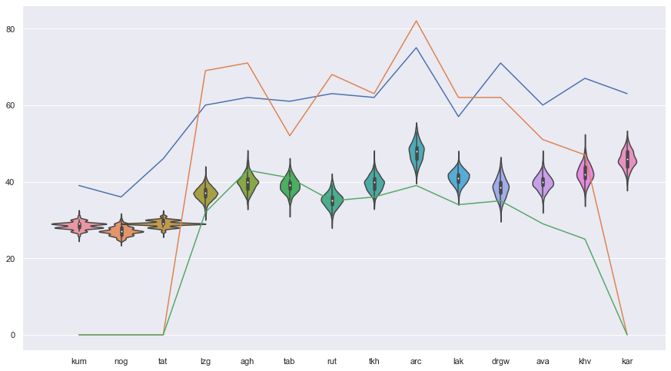
Comparison: inventory size vs. usage frequency
Orange: from the description
Blue: total in the corpus
Green: simple stops
Violins: corpus sampling
100 iterations
NB: varieties do not necessarily match those in Kibrik and Kodzasov 1990

Slide 31
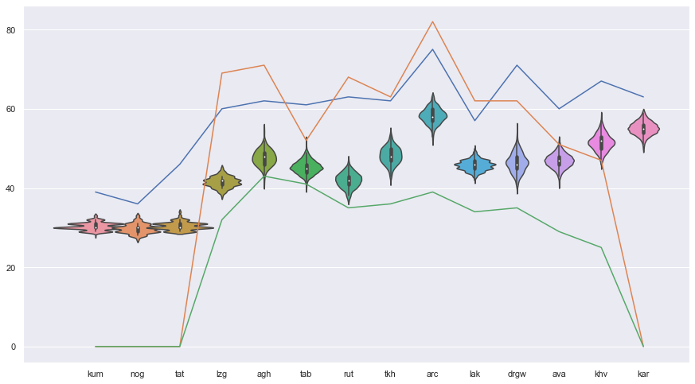
Comparison: inventory size vs. usage frequency
Orange: from the description
Blue: total in the corpus
Green: simple stops
Violins: corpus sampling
400 iterations
NB: varieties do not necessarily match those in Kibrik and Kodzasov 1990

Slide 32
Morphological complexity
in Daghestan

Slide 33
Descriptive data
Language | EC | CC | EC+CC
Batsbi | 17 | 57 | 74
Ingush | 16 | 46 | 62
Akusha | 12 | 42 | 54
Lak | 10 | 42 | 52
Hunzib | 11 | 40 | 51
Tsakhur | 9 | 41 | 50
Kryz | 11 | 38 | 49
Khinalug | 11 | 37 | 48
Icari | 15 | 31 | 46
Kubachi | 11 | 31 | 42
Udi | 7 | 35 | 42
Archi | 11 | 30 | 41
Avar | 10 | 30 | 40
Godoberi | 11 | 25 | 36
Hinuq | 9 | 25 | 34
Karata | 9 | 22 | 31
Lezgi | 4 | 22 | 26
Tindi |  | 22 | 22
rich case systems
The Guinness Book of Records (1997)
gender agreement (the majority of languages)
+ e.g., in Lak, Dargwa person agreement
large verbal paradigms, synthetic and periphrastic forms
Nichols 2020, p.c.
Notes:
Скриншот из статьи Полински Комри

Slide 34
Corpus data
translations of the Gospel of Luke
Agul, Andi, Avar, Dargwa, Lak, Lezgian, Rutul, Tabasaran, Udi + English, Russian
each translation ~ 18,000 tokens
folklore texts (non-parallel, the same as for phonetic experiments)
the number of tokens:
other texts
tsakh | agul | nog | khvar | archi | tat | rutul | tab | lak | darg | avar | lezg | kum | rus
4,495 | 4,839 | 4,967 | 6,704 | 9,094 | 18,742 | 18,845 | 23,430 | 30,796 | 31,931 | 35,532 | 39,082 | 44,748 | 288,801
Avar poetry (with comments) | 36,155 tokens | Chirag corpus | 422,565 tokens
Avar drama (Цадаса Гамзат. Пьесы.) | 49,141 tokens | English (Tom Sawyer) | 76, 664 tokens
Tokita corpus | 13,337 tokens | Russian (Анна Каренина) | 269,580 tokens

Slide 35
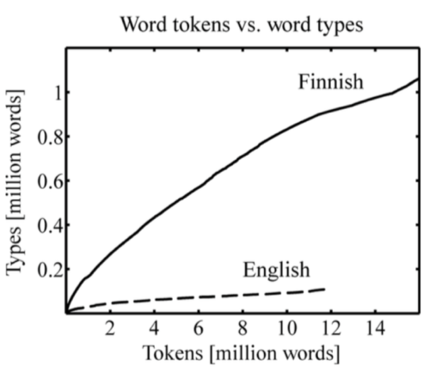
Experiment 1: Heap’s law
Heap’s law: the number of distinct words (types) in a document is a function of the document length (total number of tokens).
We can compare how the type-token ratio (TTR) gradually increases in texts in different languages, cf. Finnish vs. English
TTR in Finnish increases faster = Finnish is more complex
But in contrast to Finnish and English, most of our corpora are very small
(Creutz & Lagus 2007: 21)

Slide 36
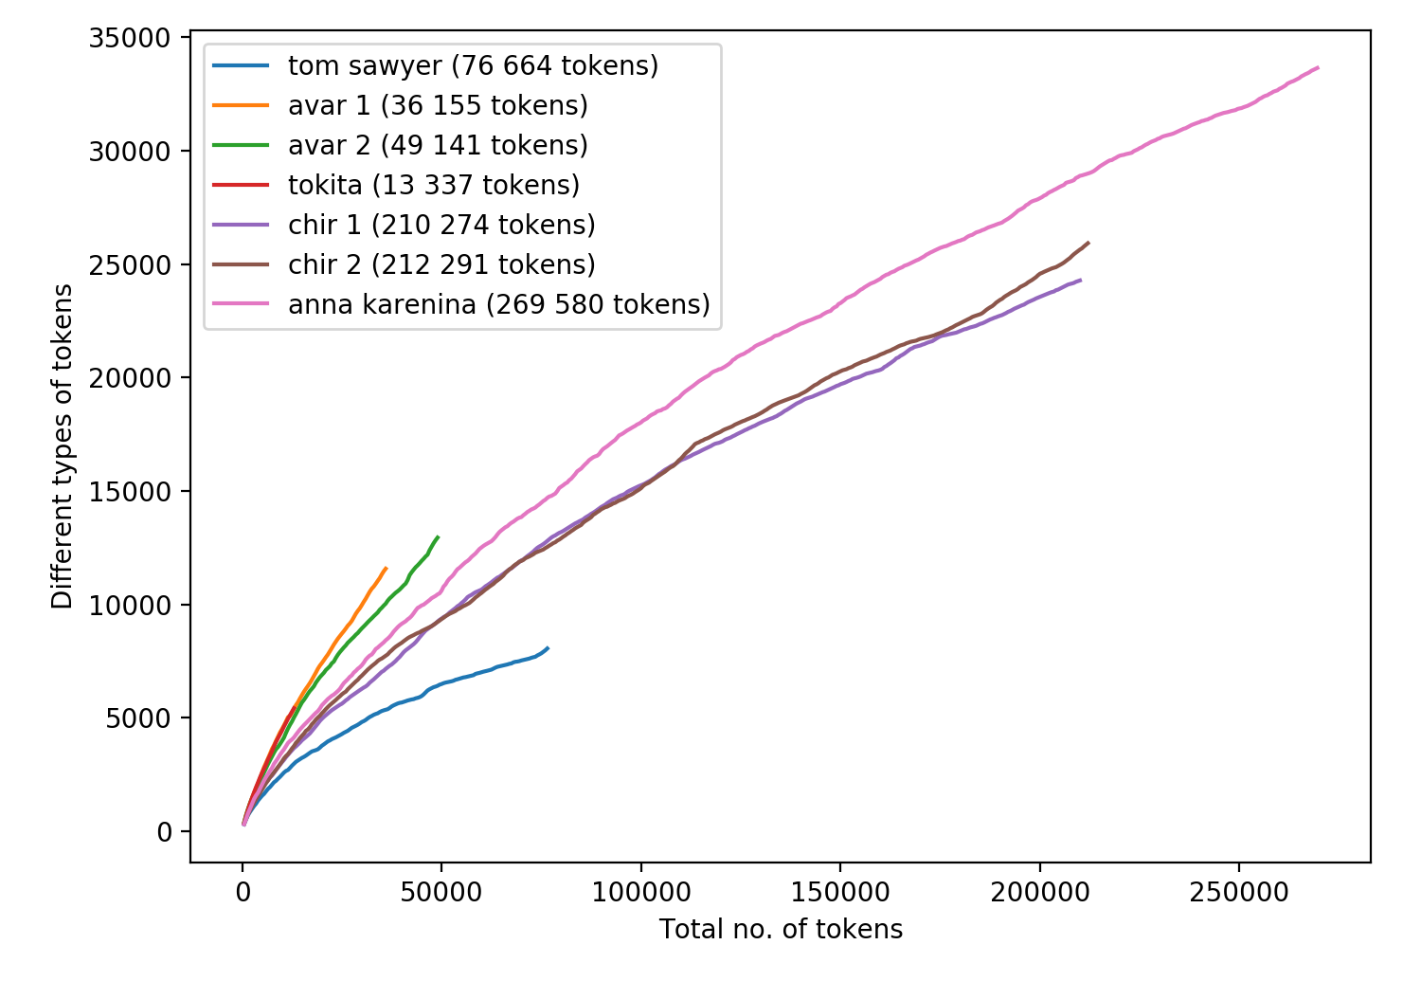
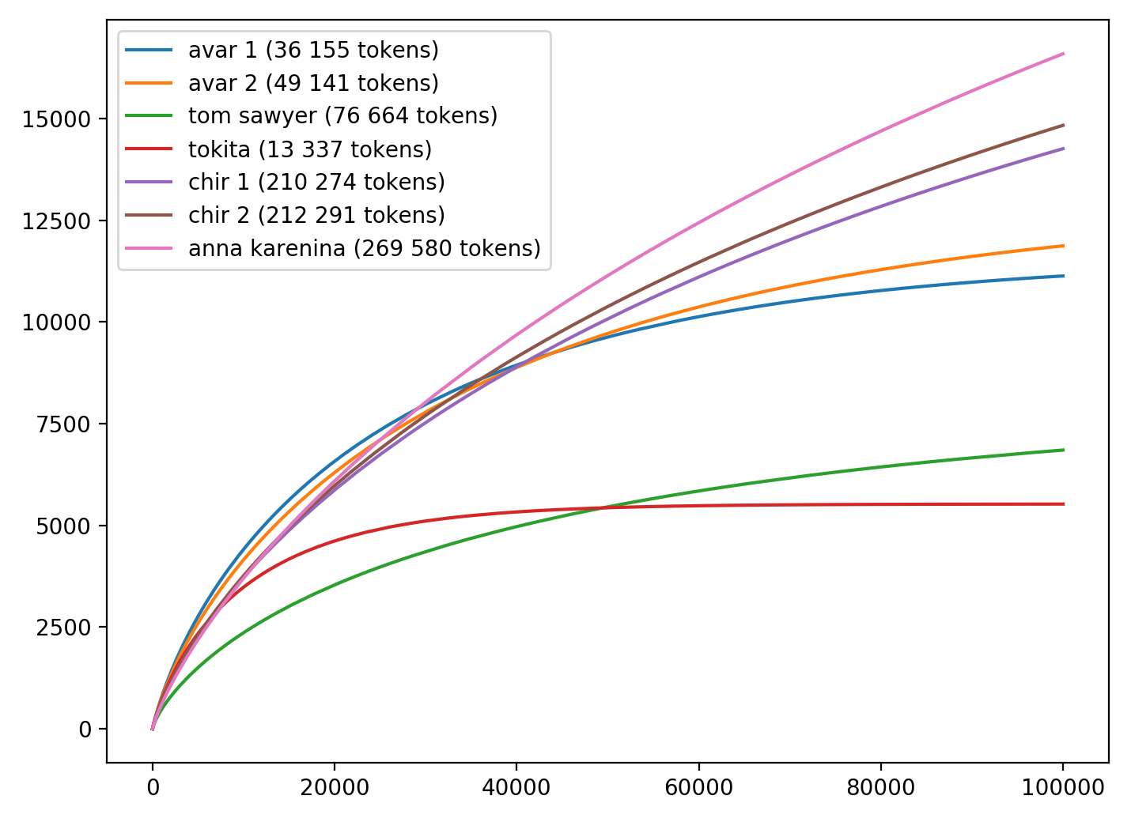
Experiment 1: Heap’s law
The idea: to compile a frequency list and add tokens from this list to the plot according to their frequency → “simulated Heap” (BUT: some curves become parallel to the asymptote very quickly, cf. Tokita)
Original Heap
Simulated Heap

Slide 37
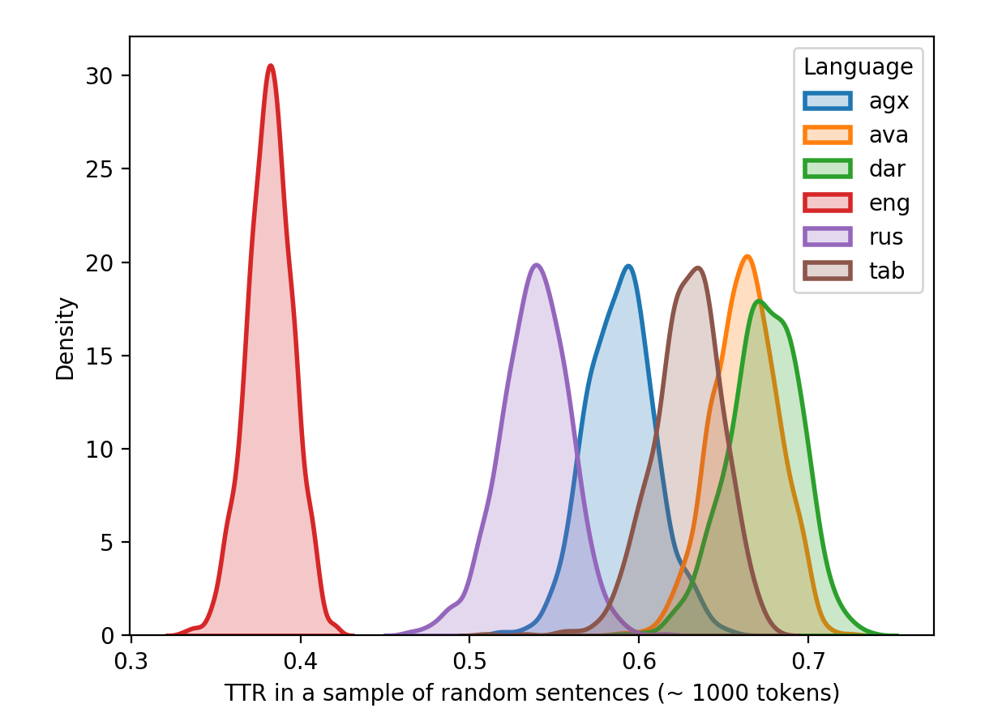
Experiment 2: sampling
The idea: to investigate TTR in small samples of sentences (~ 1000 tokens)
Algorithm (for one language):
compile a sample
select random sentences in the text as long as the total number of tokens in the sample < 1000
calculate TTR in the obtained sample
repeat 999 more times
Distribution of TTR in samples of sentences from the Gospel of Luke

Slide 38
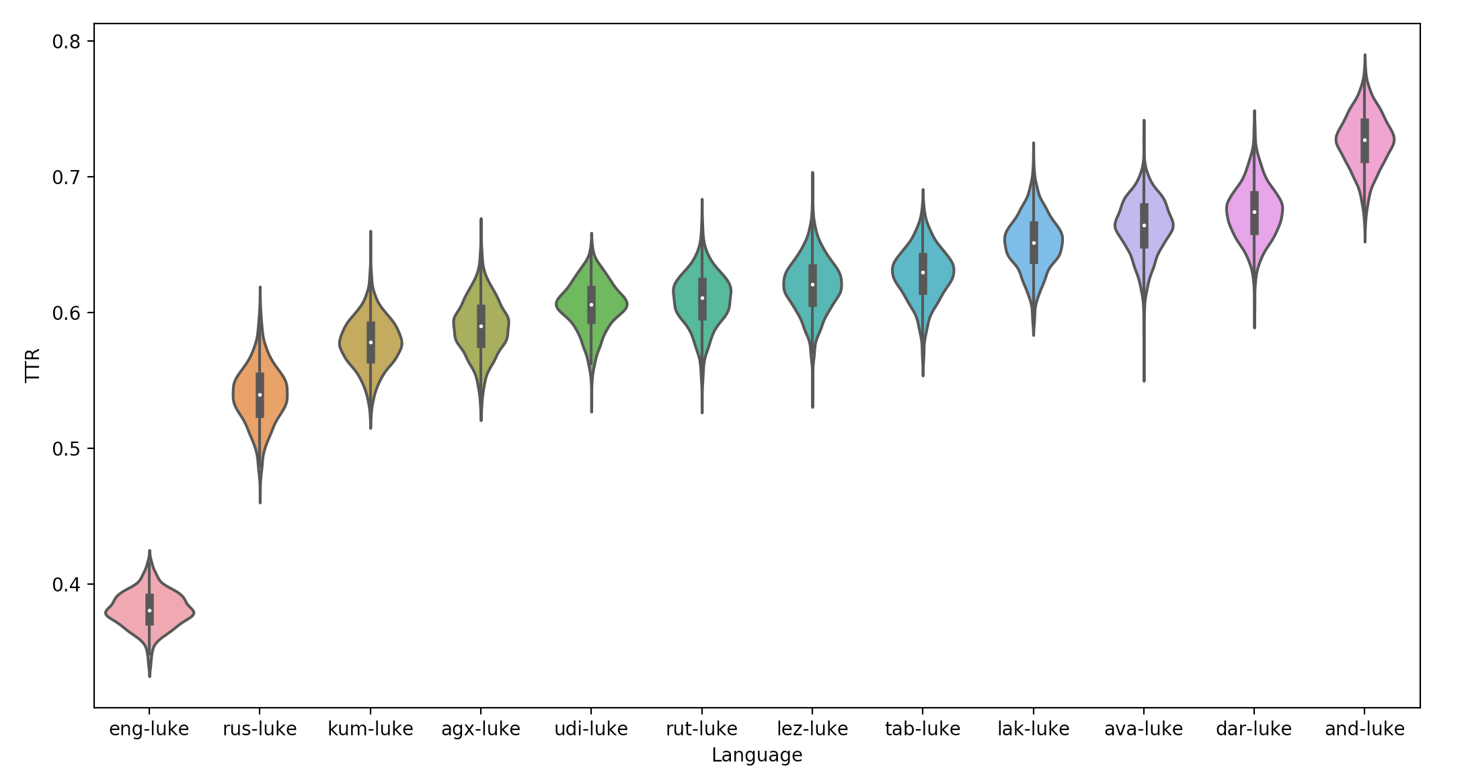
Experiment 2: sampling
More translations of the Gospel of Luke: violin plots

Slide 39
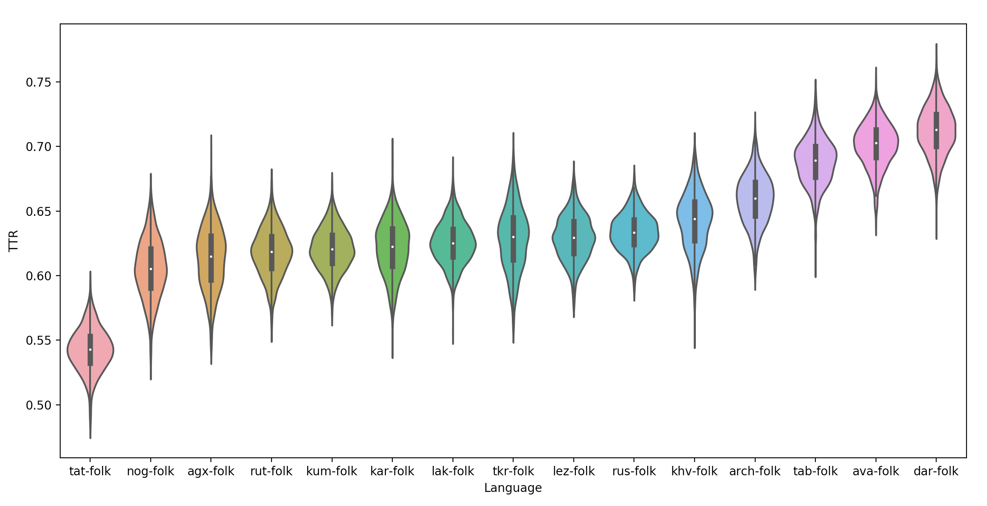
Experiment 2: sampling
Folklore texts:

Slide 40
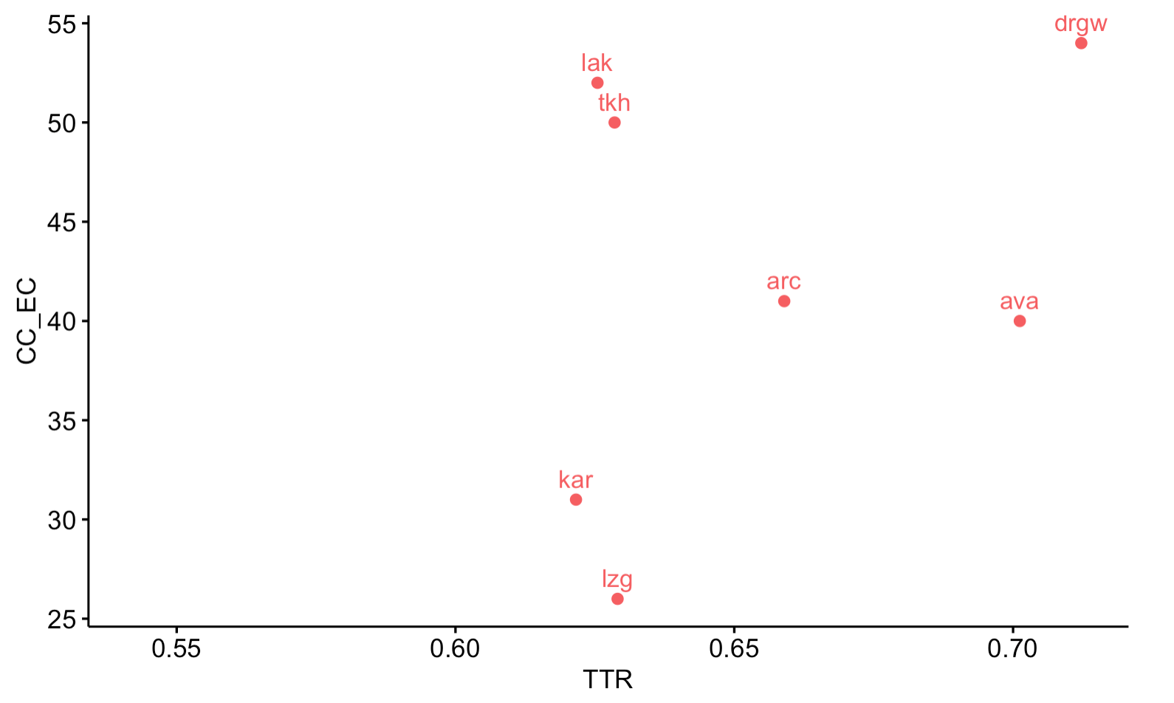
CC+EC & TTR
Notes:
based on folklore texts

Slide 41
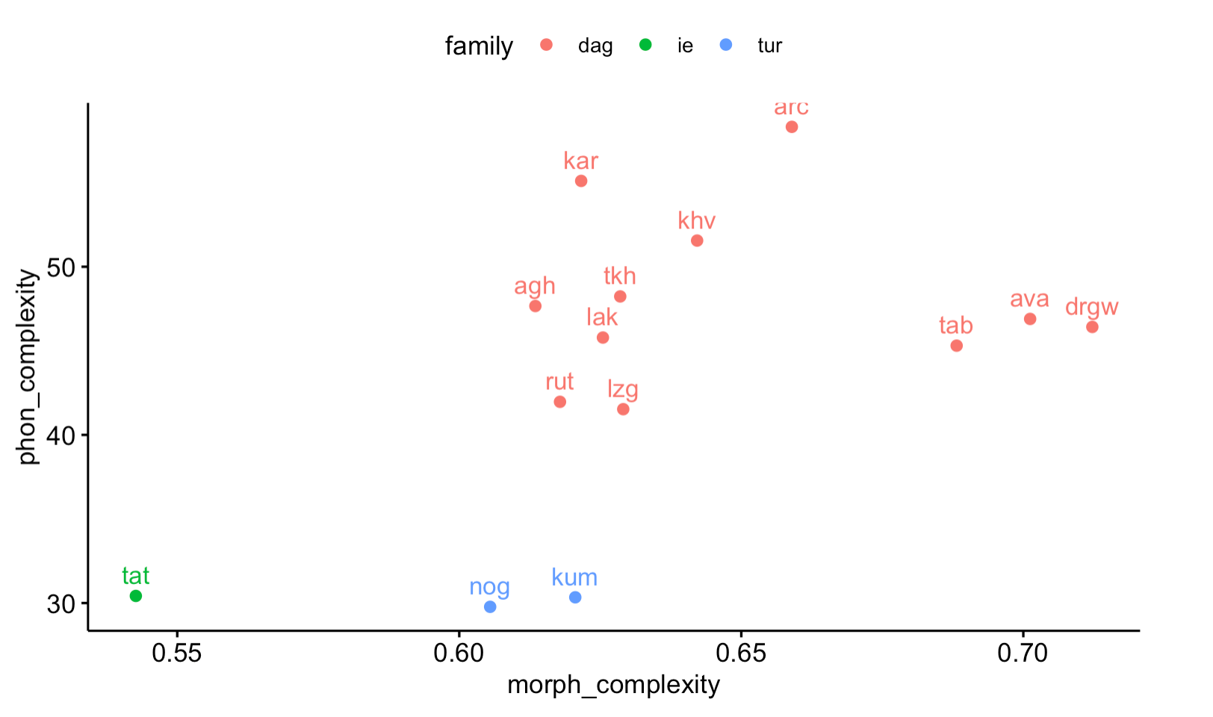
Phonetics & Morphology
Notes:
based on folklore texts

Slide 42
Prospects

Slide 43
Prospects
from phonemes to syllables
testing statistical significance of the differences between TTR distributions
correlations with extra-linguistic parameters
the number of speakers
altitude (Nichols 2013, 2020)
multilingualism

Slide 44
Thank you!

Slide 45
References
Atkinson, Q. D. (2011). Phonemic diversity supports a serial founder effect model of language expansion from Africa. Science, 332(6027), 346-349.
Baechler, R. (2017). Complexity, Isolation, and Language Change. Zeitschrift für Dialektologie und Linguistik, 84(2-3), 178-201.
Bane, M. (2008). Quantifying and measuring morphological complexity. In Proceedings of the 26th west coast conference on formal linguistics (pp. 69-76). Somerville, MA: Cascadilla Proceedings Project.
Bentz, C., Soldatova, T., Koplenig, A., & Samardžić, T. (2016). A comparison between morphological complexity measures: typological data vs. language corpora.
Çöltekin, Ç., & Rama, T. (2018). Exploiting universal dependencies treebanks for measuring morphosyntactic complexity. Proceedings of the First Shared Task on Measuring Language Complexity, 1-8.
Covington, M. A., & McFall, J. D. (2010). Cutting the Gordian knot: The moving-average type–token ratio (MATTR). Journal of quantitative linguistics, 17(2), 94-100.
Creutz, M., & Lagus, K. (2007). Unsupervised models for morpheme segmentation and morphology learning. ACM Transactions on Speech and Language Processing (TSLP), 4(1), 1-34.
Ehret and Szmrecsanyi, to appear
Ehret, K., & Szmrecsanyi, B. (2016). An information-theoretic approach to assess linguistic complexity. In R. Baechler & G. Seiler (Eds.), Complexity and Isolation. Berlin: De Gruyter.
Ehret, K. (2018). Kolmogorov complexity as a universal measure of language complexity. Proceedings of the First Shared Task on Measuring Language Complexity, 8-14.
Gutierrez-Vasques, X., & Mijangos, V. (2020). Productivity and Predictability for Measuring Morphological Complexity. Entropy, 22(1), 48.
Haudricourt, A. (1961). Richesse en phonèmes et richesse en locateurs. L' homme 1, 5-10.
Hay, J., & Bauer, L. (2007). Phoneme inventory size and population size. Language, 83(2), 388-400.

Slide 46
References
Juola, P. (1998). Measuring linguistic complexity: The morphological tier. Journal of Quantitative Linguistics, 5(3), 206-213.
Juola, P. (2008). Assessing linguistic complexity. Language complexity: Typology, contact, change, ed. by Matti Miestamo, Kaius Sinnemaki, and Fred Karlsson, 89—108. Amsterdam: John Benjamin
Kettunen, K. (2014). Can type-token ratio be used to show morphological complexity of languages?. Journal of Quantitative Linguistics, 21(3), 223-245.
Kibrik, A. E. (1977). Opyt strukturnogo opisaniya archinskogo yazyka. M.: MGU.
McWhorter, J. H. (2001). The worlds simplest grammars are creole grammars. Linguistic typology, 5(2-3), 125-166.
Nichols 1992
Nichols, J. (2009). Linguistic complexity: A comprehensive definition and survey. In Geoffrey Sampson, David Gil, and Peter Trudgill (eds), Language Complexity as an Evolving Variable. Oxford: Oxford University Press, 110–25.
Nichols, J. (2013). The vertical archipelago: Adding the third dimension to linguistic geography. In Peter Auer, Martin Hilpert, Anja Stukenbrock, and Benedikt Szmrecsanyi (eds), Space in Language and Linguistics. Berlin: Mouton de Gruyter, 38–60.
Nichols, J. (2020). Canonical complexity. In P. Arkadiev & F. Gardani (Eds.), The complexities of morphology (pp. 163–192). Oxford University Press.
Sozinova, O., Ch. Bentz, T. Samardzic. (2019). Measuring inflectional and derivational complexity.
Trudgill, P. (2004). Linguistic and social typology: The Austronesian migrations and phoneme inventories. Linguistic Typology, 8(3), 305-320.
Xanthos, A., & Gillis, S. (2010). Quantifying the development of inflectional diversity. First language, 30(2), 175-198.

